Slide 1
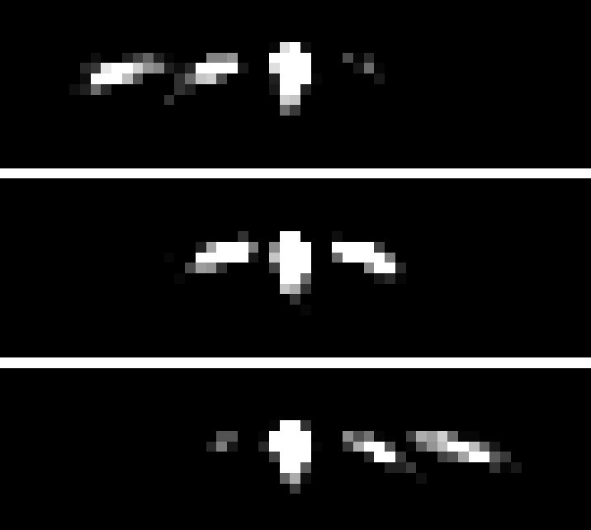

ANALYSIS OF NEUTRON DIFFRACTION BY OPTICALLY THIN GRATING
Student:
Ismaele Vincent Masiello
Supervisors:
Simon E. Wall¹
Jürgen Klepp²
¹Department of Physics and Astronomy, University of Aarhus, Ny Munkegade, Building 1520, DK-8000 Aarhus C, Denmark
²University of Vienna, Faculty of physics, Boltzmanngasse 5, 1090 Vienna, Austria

Slide 2
INTRODUCTION

Slide 3
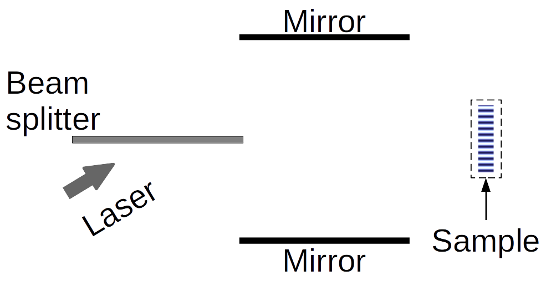
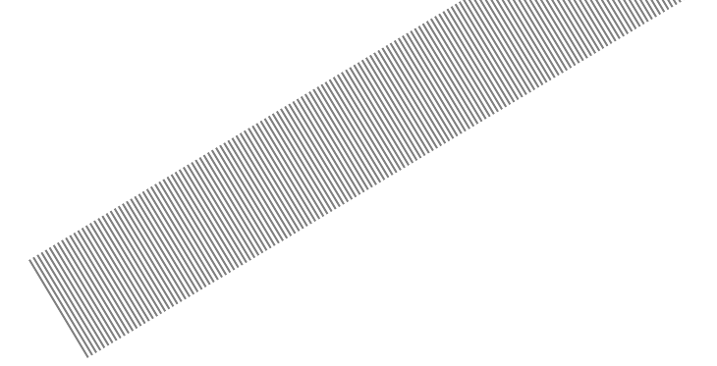
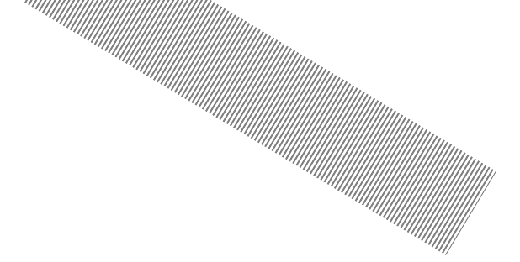
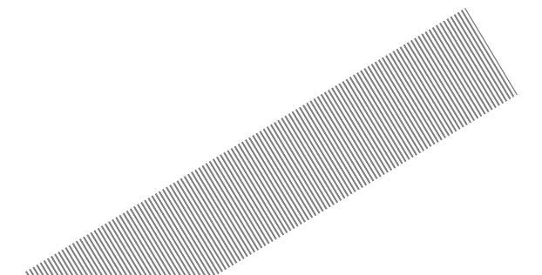
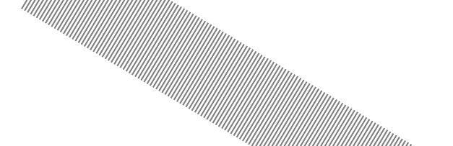
HOLOGRAPHIC GRATINGS

Slide 4

DIFFRACTION EXPERIMENT
-2
-1
Incoming
beam
0
1
θ

Slide 5
OPTICALLY THICK/THIN GRATINGS
. . .
-2
-2
-1
-1
Incoming
Incoming
beam
0
beam
0
1
. . .
T. K. Gaylord and M. G. Moharam. “Thin and thick gratings: terminology clarification”. In: Appl. Opt. 20.19 (Oct. 1981), pp. 3271–3273.

Slide 6
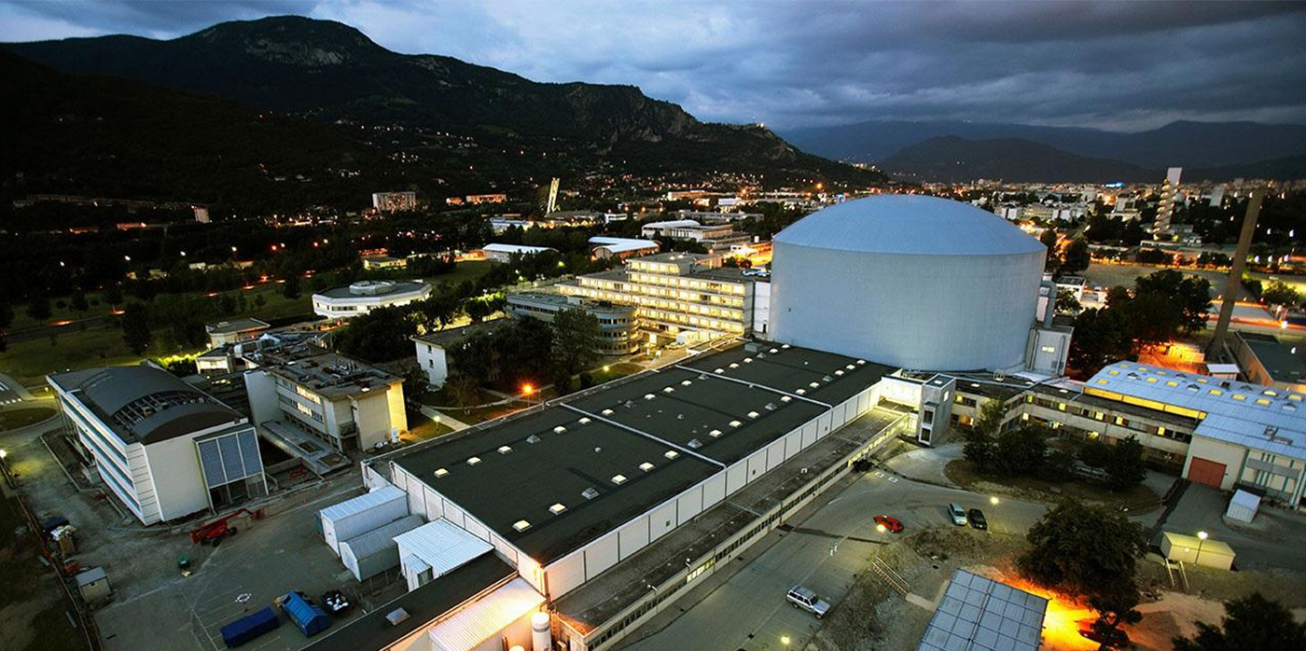
THE DATA

Slide 7
THEORY
FIRST-ORDER MULTI-WAVE MODEL

Slide 8
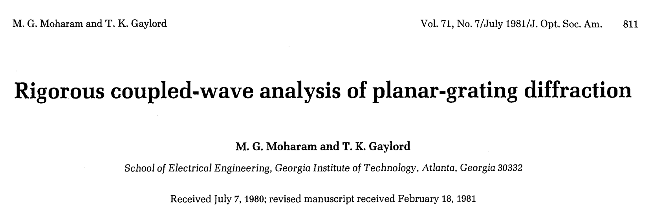
RCWA
What follows is a re-adaptation and approximation of the Rigorous Coupled-Wave Analysis (RCWA) presented by M. G. Moharam and T. K. Gaylord.
M. G. Moharam and T. K. Gaylord. “Rigorous coupled-wave analysis of planar-grating diffraction”. In: J. Opt. Soc. Am. 71.7 (July 1981), pp. 811–818.

Slide 9
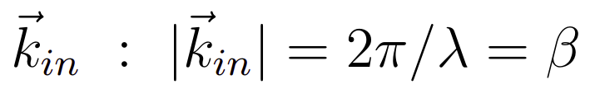
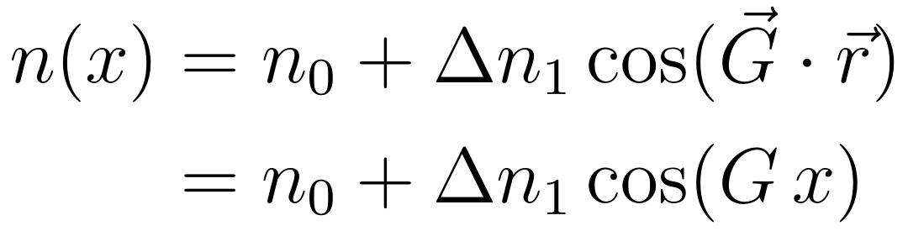
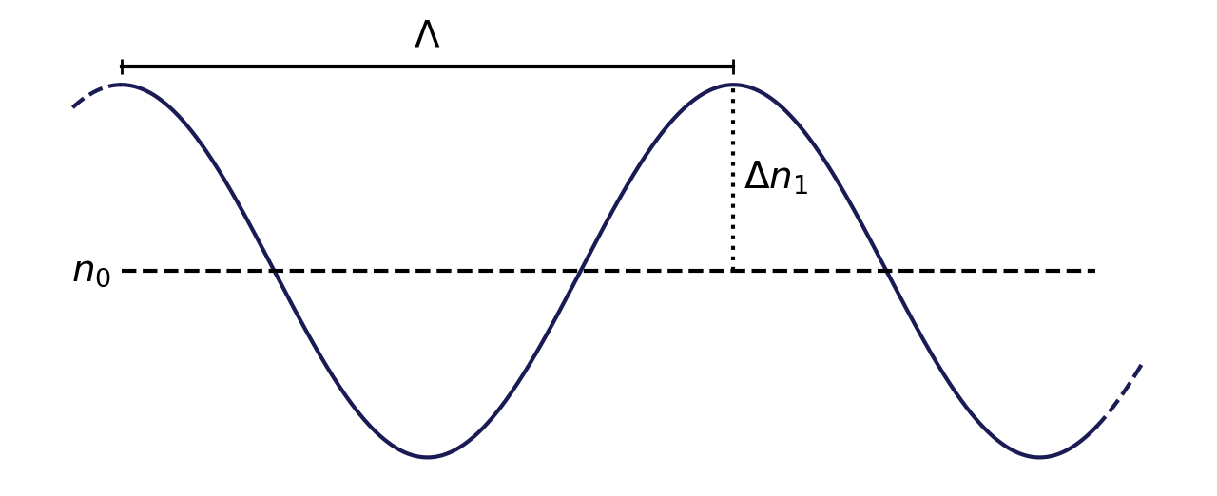
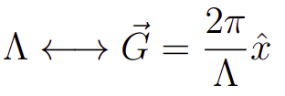
HOLOGRAPHIC GRATING
d
REFRACTIVE INDEX PROFILE
Incoming
beam
n
z
x
x

Slide 10
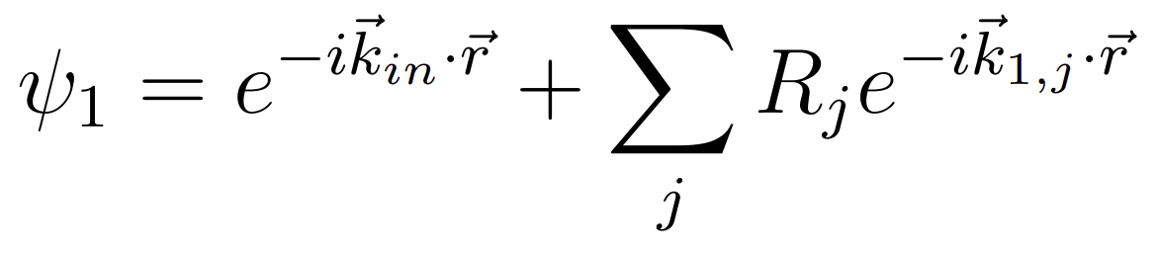
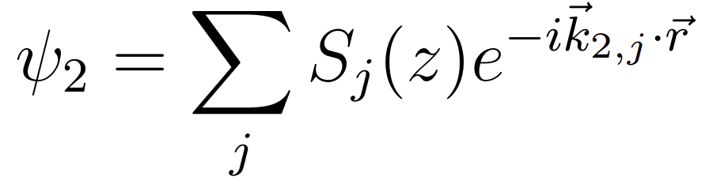
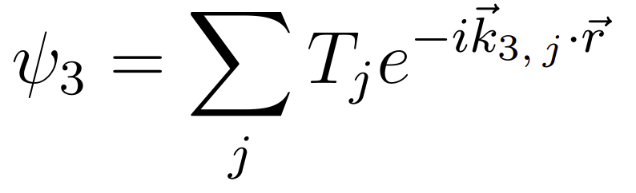
REFRACTIVE INDEX PROFILE
Region
1
Region
2
Region
3
Forward
diffracted
waves
REFRACTIVE INDEX PROFILE
REGION 1
. . .
. . .
-2
-2
-1
-1
REGION 2
0
0
z
+1
+1
. . .
. . .
Backward
diffracted
waves
REGION 3
x

Slide 11
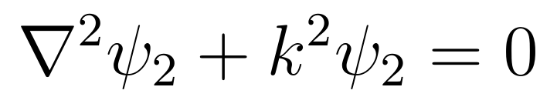
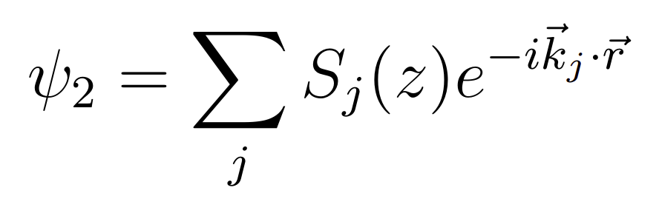
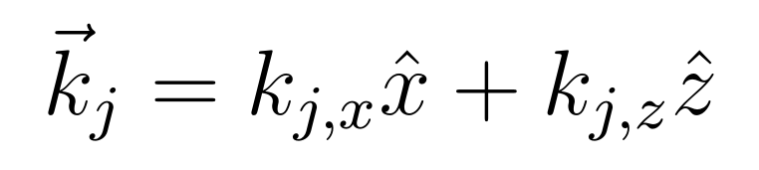
REGION 2
TIME INDEPENDENT WAVE EQUATION

Slide 12
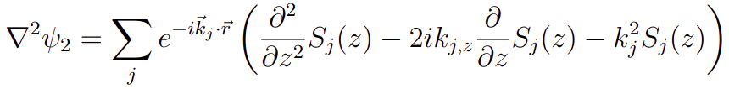
REGION 2
TIME INDEPENDENT WAVE EQUATION

Slide 13
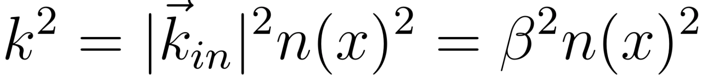
REGION 2
TIME INDEPENDENT WAVE EQUATION
REFRACTIVE INDEX PROFILE

Slide 14

REGION 2
TIME INDEPENDENT WAVE EQUATION
Martin Fally, J ̈urgen Klepp, and Yasuo Tomita. “An experimental study on the validity of diffraction theories for off-Bragg replay of volume holographic gratings”. In: Applied Physics B 108 (July 2012).

Slide 15
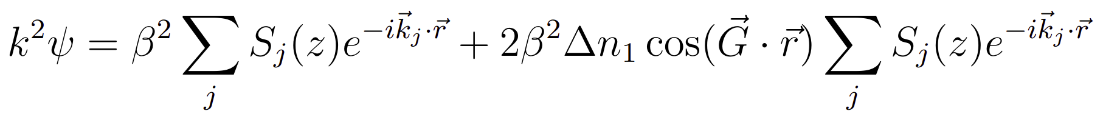
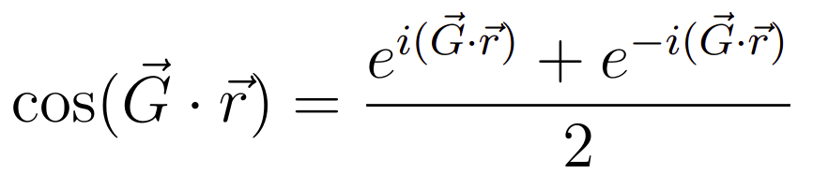
REGION 2
TIME INDEPENDENT WAVE EQUATION

Slide 16
REGION 2
TIME INDEPENDENT WAVE EQUATION

Slide 17

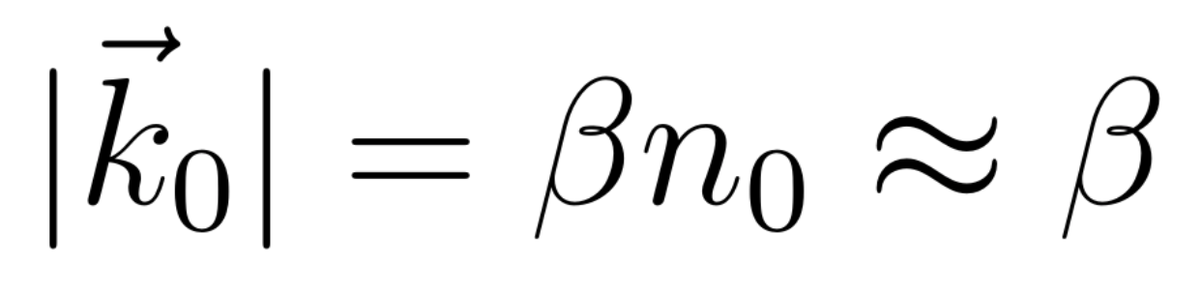
Region
1
Region
2
FLOQUET’S CONDITION
z
x
Martin Fally, J ̈urgen Klepp, and Yasuo Tomita. “An experimental study on the validity of diffraction theories for off-Bragg replay of volume holographic gratings”. In: Applied Physics B 108 (July 2012).
Matej Prijatelj et al. “Far-off-Bragg reconstruction of volume holographic gratings: A comparison of experiment and theories”. In: Physical Review A 87.6 (June 2013).

Slide 18
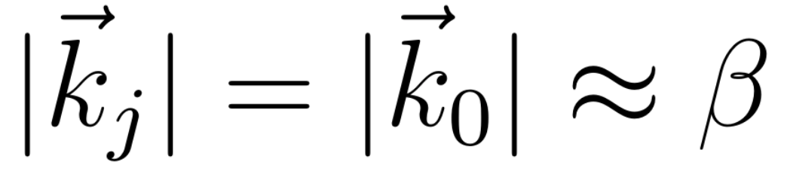
Region
1
Region
2
FLOQUET’S CONDITION
. . .
z
. . .
BETA VALUE METHOD (BVM)
x
Martin Fally, J ̈urgen Klepp, and Yasuo Tomita. “An experimental study on the validity of diffraction theories for off-Bragg replay of volume holographic gratings”. In: Applied Physics B 108 (July 2012).
Matej Prijatelj et al. “Far-off-Bragg reconstruction of volume holographic gratings: A comparison of experiment and theories”. In: Physical Review A 87.6 (June 2013).

Slide 19
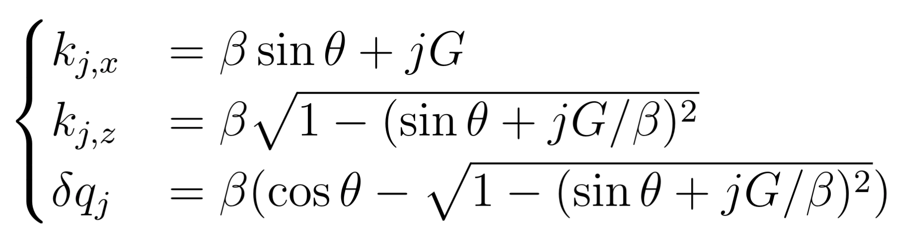
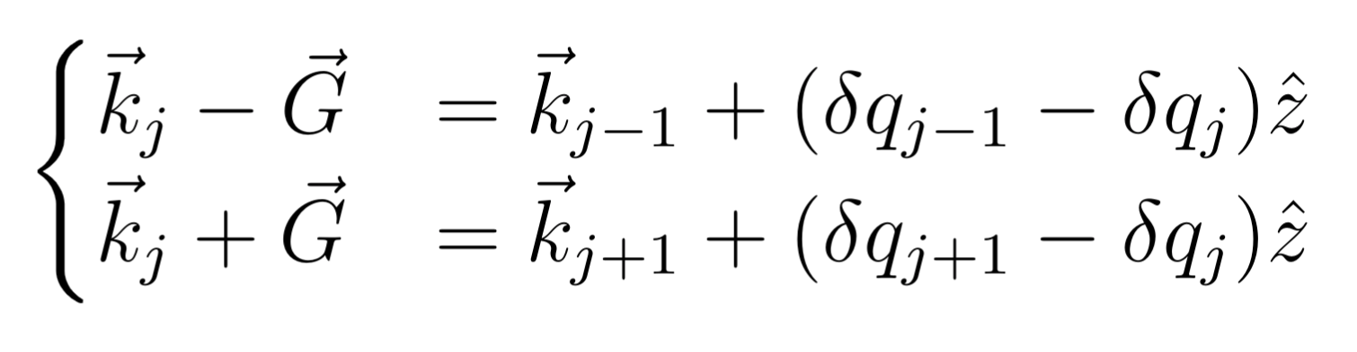
Region
1
Region
2
. . .
z
. . .
x

Slide 20
REGION 2
TIME INDEPENDENT WAVE EQUATION

Slide 21
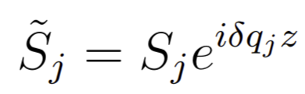
REGION 2
TIME INDEPENDENT WAVE EQUATION
FIRST ORDER APPROXIMATION OF RCWA

Slide 22
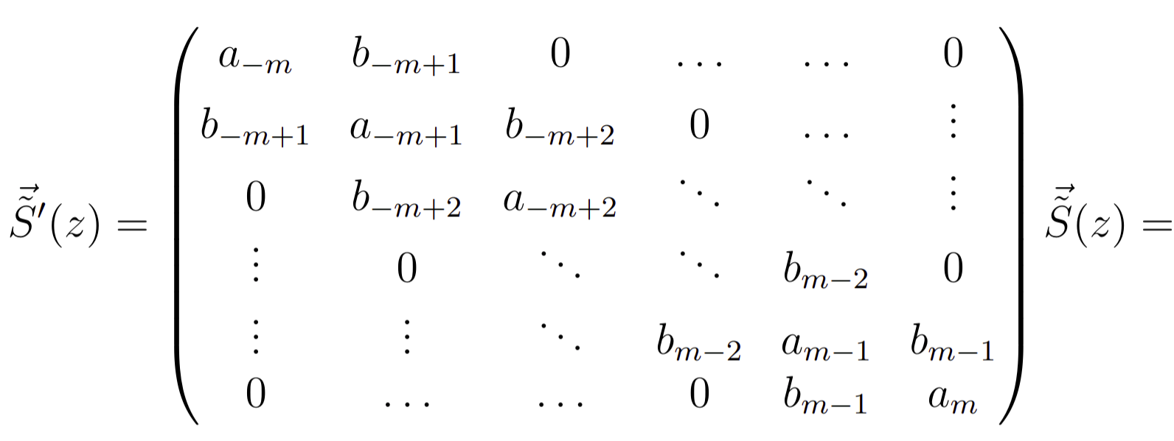
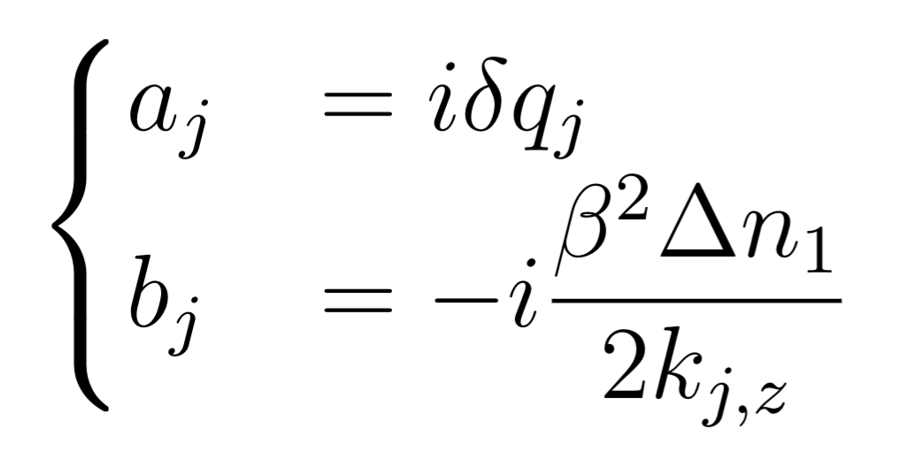
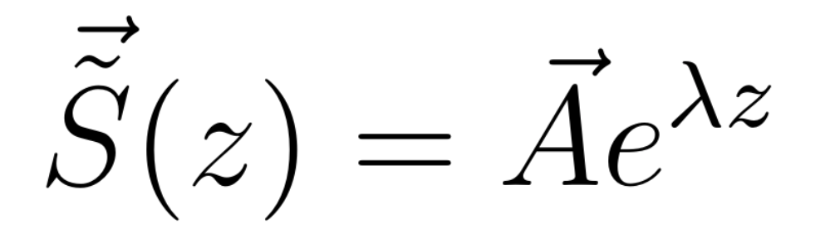
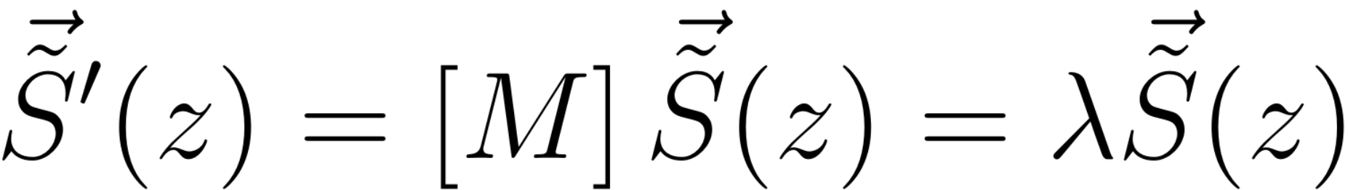
REGION 2
FIRST ORDER APPROXIMATION OF RCWA
Ansatz
Eigenvalue equation

Slide 23
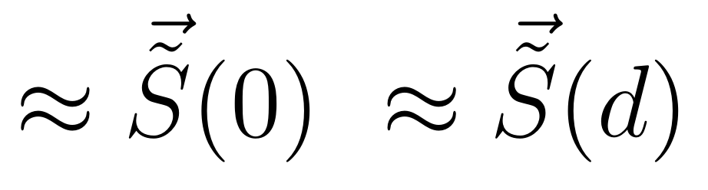
Region
1
Region
2
Region
3
Forward
diffracted
waves
. . .
. . .
-2
-2
-1
-1
0
0
z
+1
+1
. . .
. . .
Backward
diffracted
waves
x

Slide 24
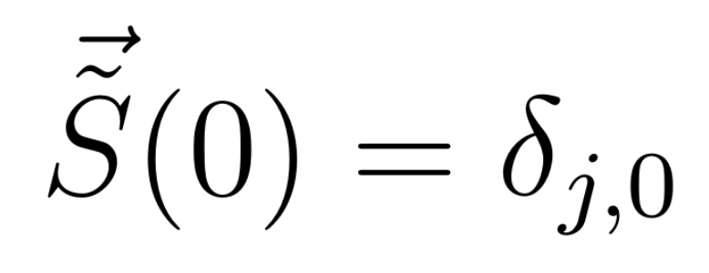
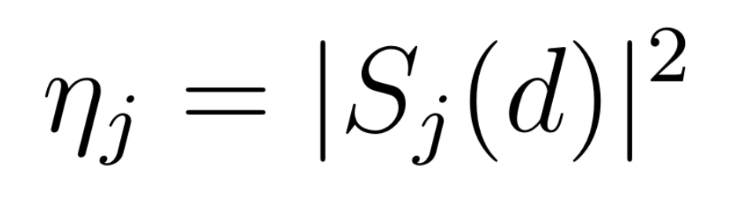
DIFFRACTION EFFICIENCIES
INITIAL CONDITIONS
J-TH ORDER DIFFRACTION EFFICIENCY

Slide 25
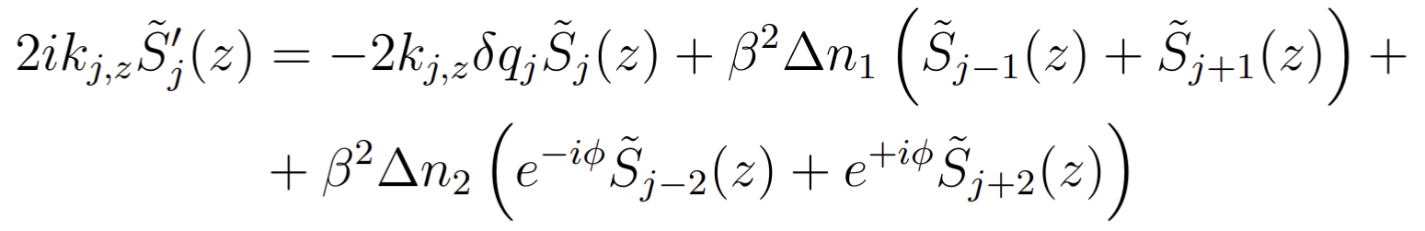
HIGHER FOURIER COMPONENTS
TWO FOURIER COMPONENTS OF THE REFRACTIVE INDEX MODULATION
FIRST ORDER WAVE EQUATION

Slide 26
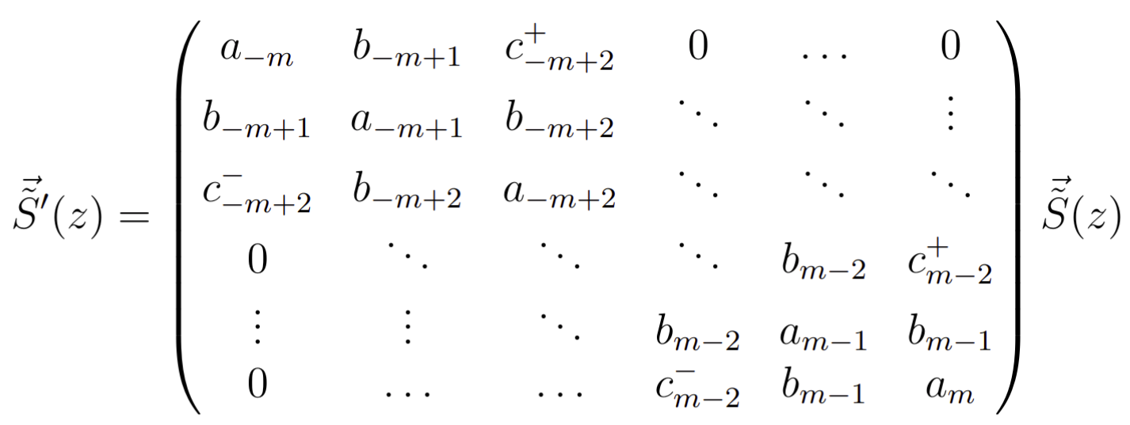
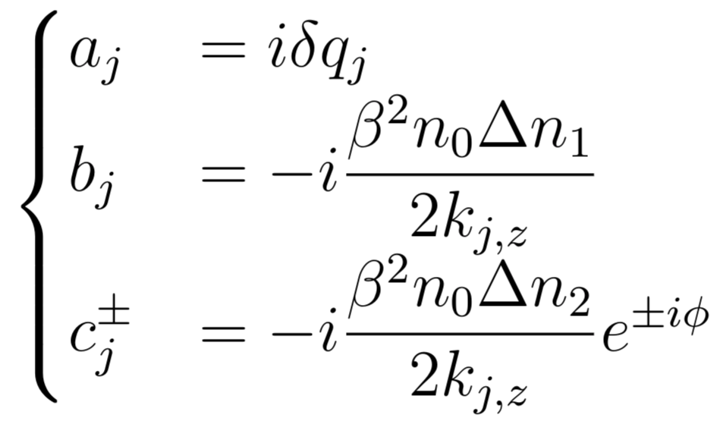
HIGHER FOURIER COMPONENTS

Slide 27
THEORY
PENDELLÖSUNG INTERFERENCE

Slide 28
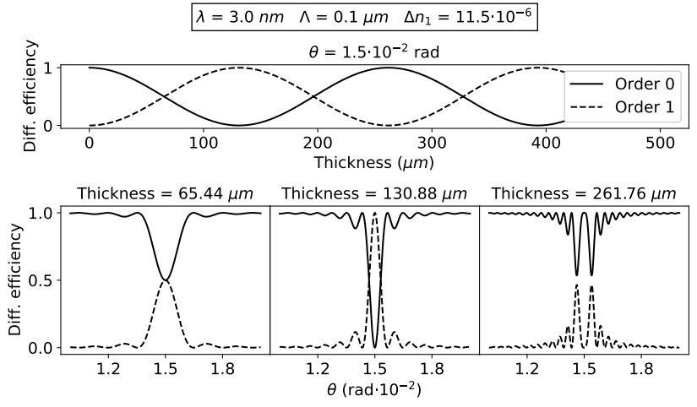
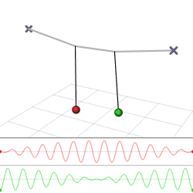
PENDELLÖSUNG INTERFERENCE
Pendellösung: (English) Pendulum solution
FIXED:
Wavelength
Incident angle
Modulation profile

Slide 29
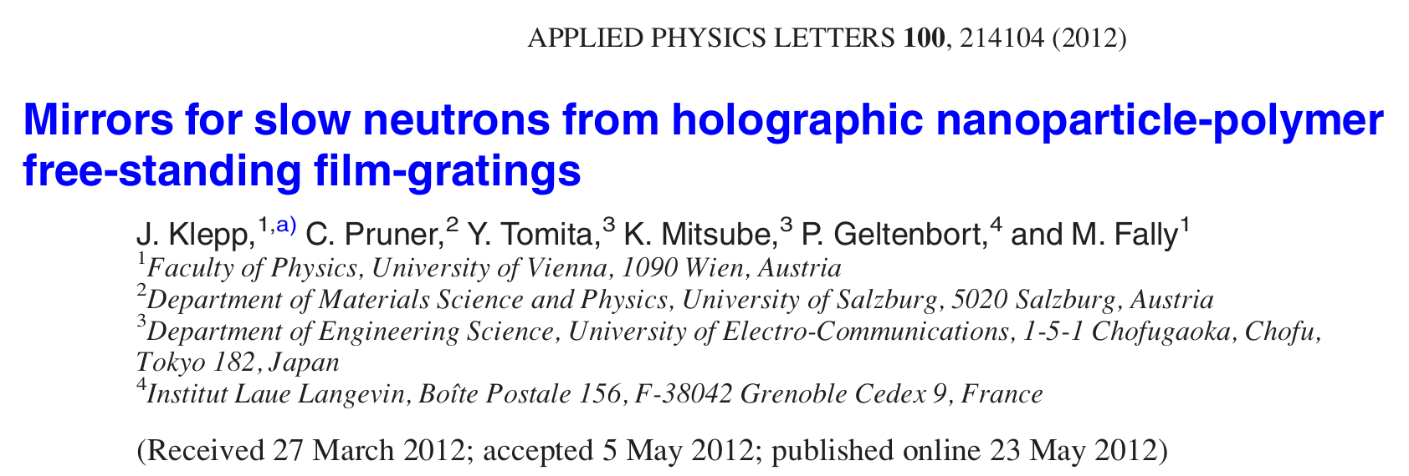
PENDELLÖSUNG INTERFERENCE
Christian Pruner et al. “Interferometer for cold neutrons”. In: Nuclear Instruments and Methods in Physics Research Section A: Accelerators, Spectrometers, Detectors and Associated Equipment 560.2 (2006), pp. 598–605. issn: 0168-9002

Slide 30
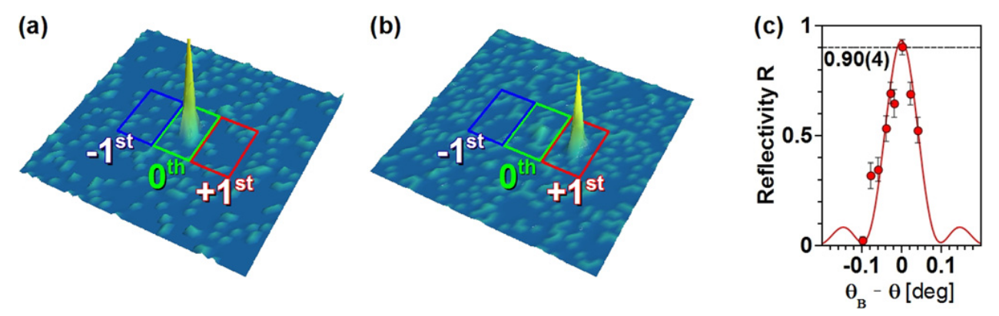
PENDELLÖSUNG INTERFERENCE
Christian Pruner et al. “Interferometer for cold neutrons”. In: Nuclear Instruments and Methods in Physics Research Section A: Accelerators, Spectrometers, Detectors and Associated Equipment 560.2 (2006), pp. 598–605. issn: 0168-9002

Slide 31
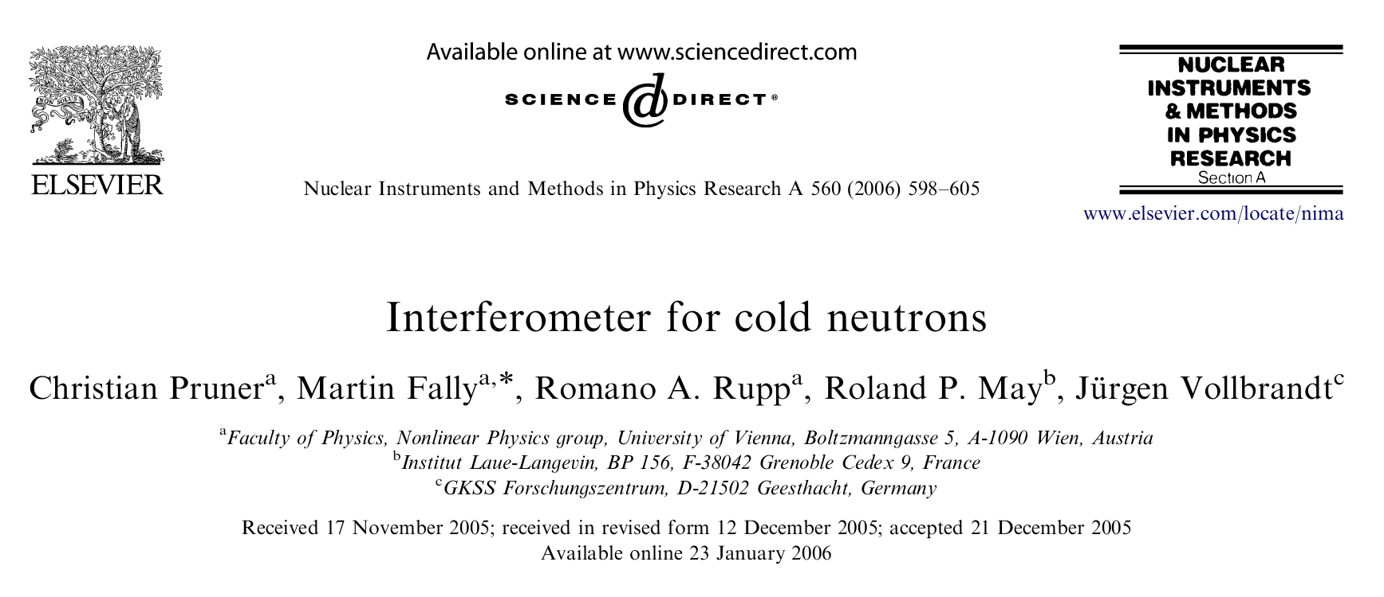
PENDELLÖSUNG INTERFERENCE
Christian Pruner et al. “Interferometer for cold neutrons”. In: Nuclear Instruments and Methods in Physics Research Section A: Accelerators, Spectrometers, Detectors and Associated Equipment 560.2 (2006), pp. 598–605. issn: 0168-9002

Slide 32
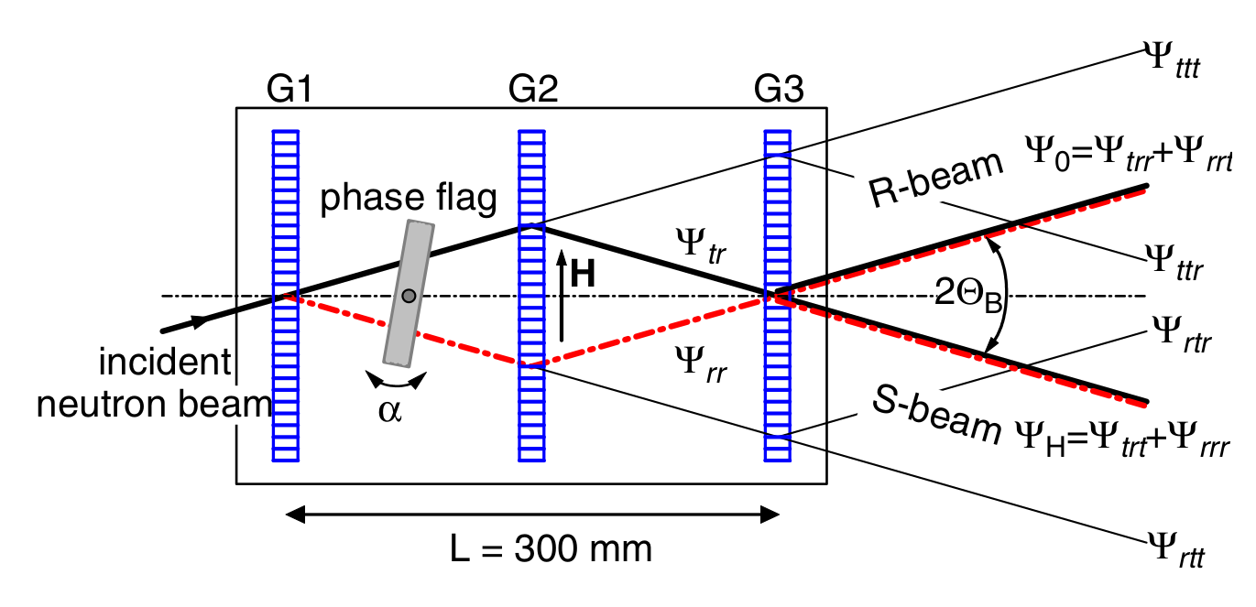
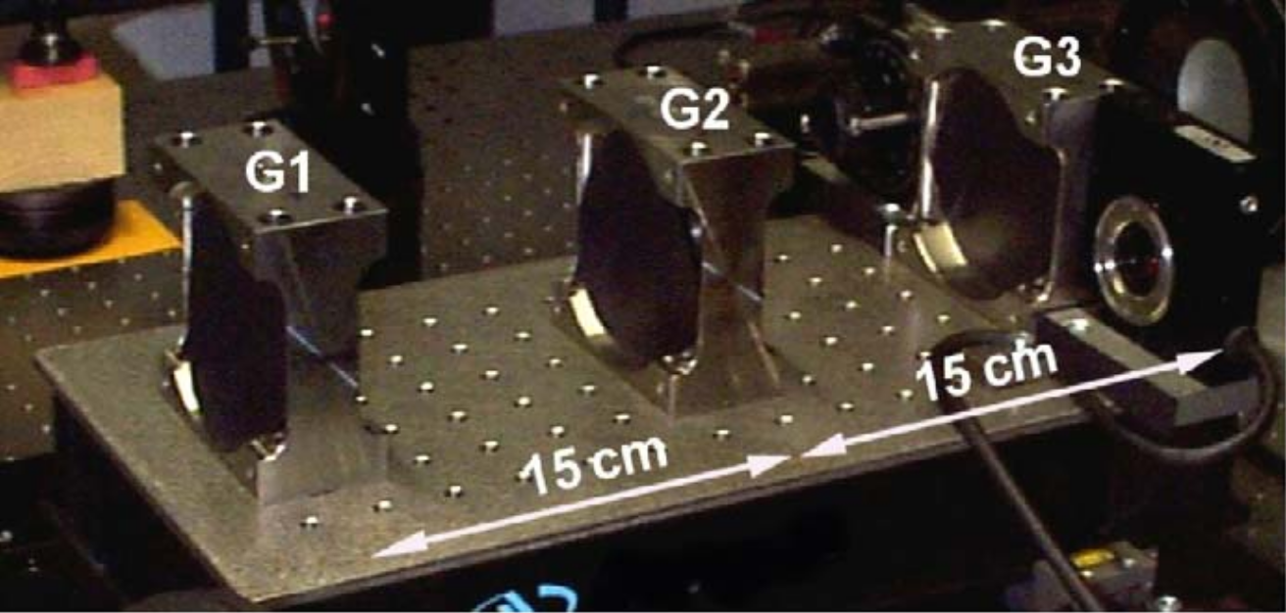
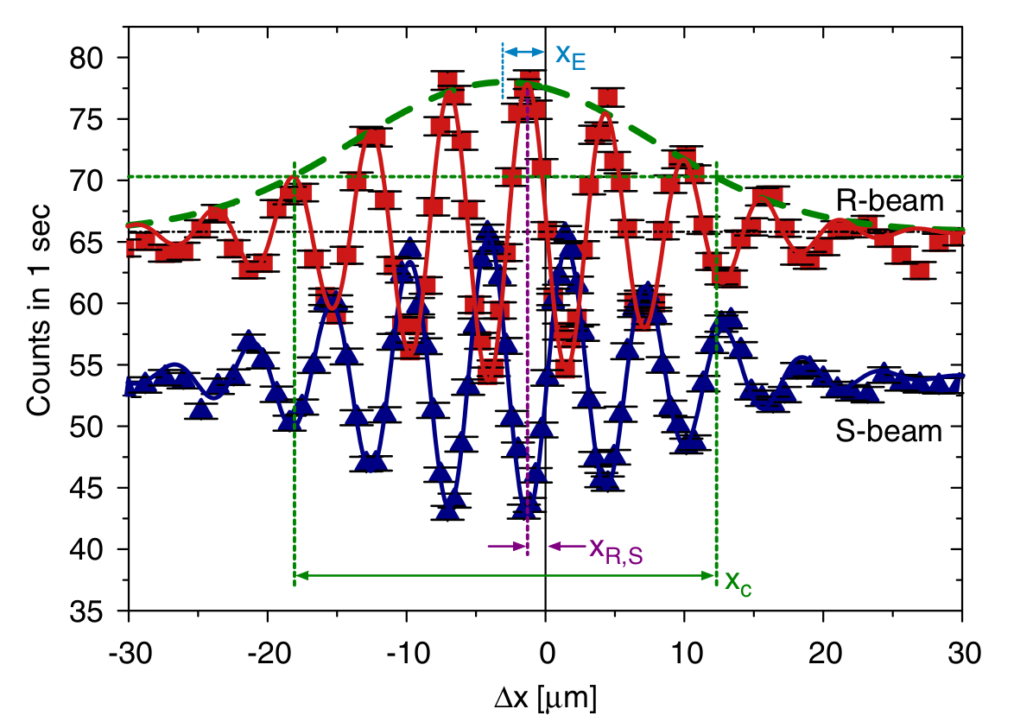
PENDELLÖSUNG INTERFERENCE

Slide 33
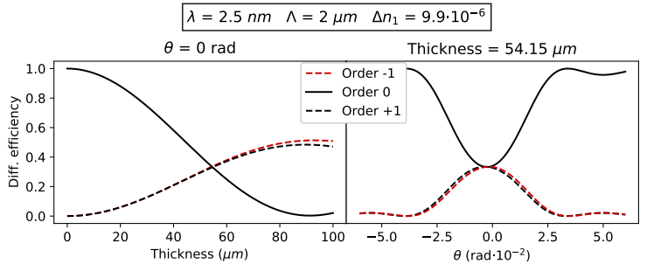
PENDELLÖSUNG INTERFERENCE

Slide 34
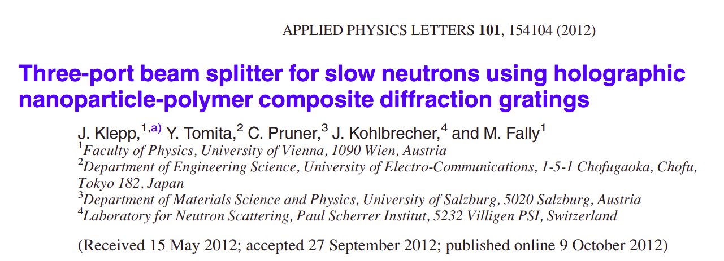
PENDELLÖSUNG INTERFERENCE
Jürgen Klepp et al. “Three-port beam splitter for slow neutrons using holographic nanoparticle-polymer composite diffraction gratings”. In: Applied Physics Letters 101.15 (2012), p. 154104.

Slide 35
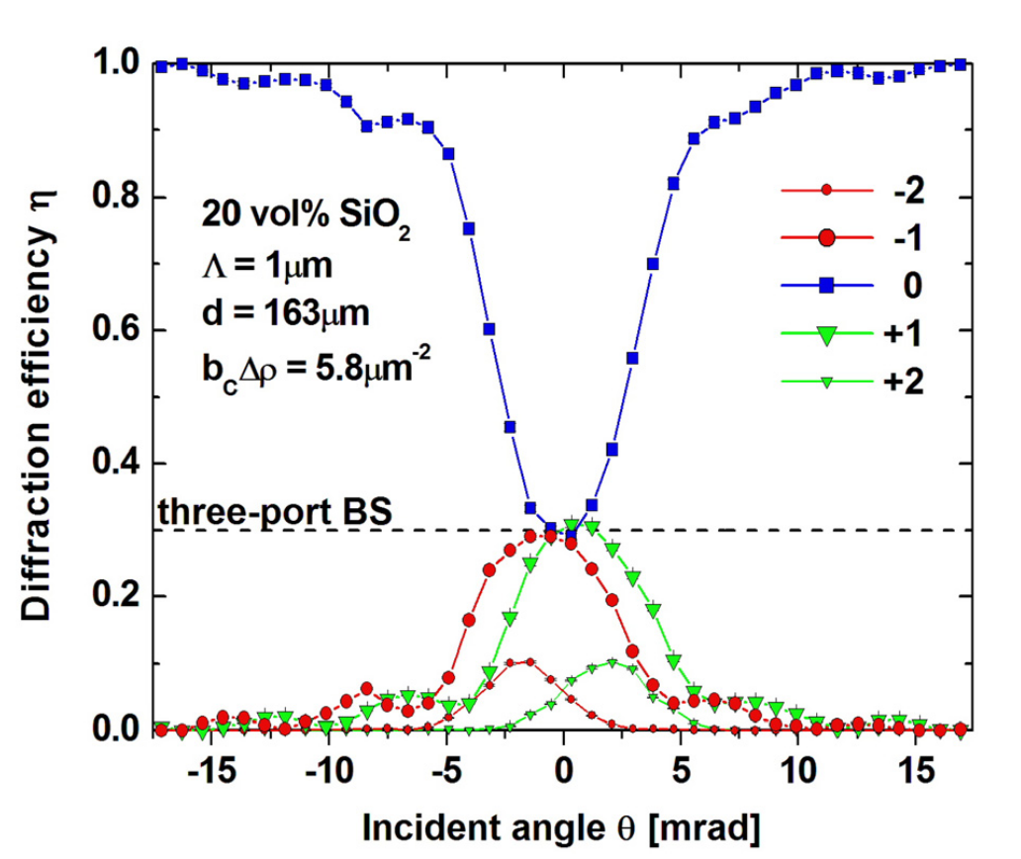
PENDELLÖSUNG INTERFERENCE
Jürgen Klepp et al. “Three-port beam splitter for slow neutrons using holographic nanoparticle-polymer composite diffraction gratings”. In: Applied Physics Letters 101.15 (2012), p. 154104.

Slide 36
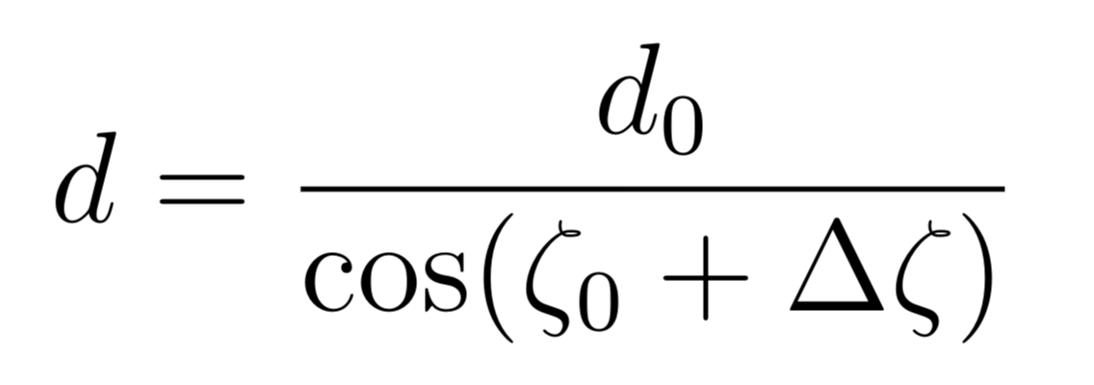
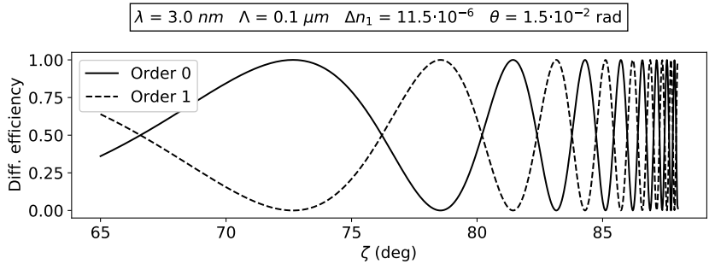
PENDELLÖSUNG INTERFERENCE
θ
THICKNESS MODULATION BY TILT
ζ
Incoming
beam
Diff. grating

Slide 37

PENDELLÖSUNG INTERFERENCE

Slide 38
THE EXPERIMENT

Slide 39
THE SAMPLE
NANOPARTICLE-POLYMER COMPOSITE (NPC) DIFFRACTION GRATING
d
Thickness (d) | Grating period (Λ)
78 μm | 0.5 μm

Slide 40

THE SAMPLE
NANOPARTICLE-POLYMER COMPOSITE (NPC) DIFFRACTION GRATING¹
LIGHT INTENSITY PROFILE
¹Yasuo Tomita, Naoaki Suzuki, and Katsumi Chikama. “Holographic manipulation of nanoparticle distribution morphology in nanoparticle-dispersed photopolymers”. In: Optics letters 30.8 (2005), pp. 839–841.

Slide 41

THE SAMPLE
NANOPARTICLE-POLYMER COMPOSITE (NPC) DIFFRACTION GRATING¹
¹Yasuo Tomita, Naoaki Suzuki, and Katsumi Chikama. “Holographic manipulation of nanoparticle distribution morphology in nanoparticle-dispersed photopolymers”. In: Optics letters 30.8 (2005), pp. 839–841.

Slide 42

THE SAMPLE
NANOPARTICLE-POLYMER COMPOSITE (NPC) DIFFRACTION GRATING¹
NEUTRON REFRACTIVE INDEX²
²Varley F. Sears. Neutron Optics: An Introduction to the Theory of Neutron Optical Phenomena and Their Applications. Oxford series on neutron scattering in condensed matter. Oxford University Press, 1989.

Slide 43

THE SAMPLE
NANOPARTICLE-POLYMER COMPOSITE (NPC) DIFFRACTION GRATING¹
NEUTRON REFRACTIVE INDEX²
SCATTERING LENGTH-DENSITY
PARAMETER MODULATION^{3,4}
³Martin Fally, J ̈urgen Klepp, and Yasuo Tomita. “An experimental study on the validity of diffraction theories for off-Bragg replay of volume holographic gratings”. In: Applied Physics B 108 (July 2012).
⁴Jürgen Klepp et al. “Mirrors for slow neutrons from holographic nanoparticle -polymerfree-standing film-gratings”. In: Applied Physics Letters 100 (Mar. 2012), p. 214104.

Slide 44

THE SAMPLE
NANOPARTICLE-POLYMER COMPOSITE (NPC) DIFFRACTION GRATING¹
REFRACTIVE INDEX MODULATION PROFILE
¹Yasuo Tomita, Naoaki Suzuki, and Katsumi Chikama. “Holographic manipulation of nanoparticle distribution morphology in nanoparticle-dispersed photopolymers”. In: Optics letters 30.8 (2005), pp. 839–841.

Slide 45
THE MEASUREMENTS
θ
Incoming
beam
θ
-2
1
-1
0

Slide 46
THE MEASUREMENTS
θ
θ
ζ
ζ
Incoming
beam
Diff. grating
Diff. grating

Slide 47

THE MEASUREMENTS
-2
-1
0
+1
+2

Slide 48

THE MEASUREMENTS

Slide 49

THE MEASUREMENTS

Slide 50
EXPERIMENTAL SET-UP
190 cm
15 cm
146 cm
18 cm
Helium pipe
Helium pipe
Mirror
175 cm
130 cm
Neutron
beam
Sample
Cadmium frame with
~1x1 cm²
aperture
1x1 mm²
apertures

Slide 51





THE INSTRUMENT
INSTUTE LAUE-LANGEVIN - PF2
VERY COLD NEUTRONS
EXPONENTIALLY MODIFIED GAUSSIAN
Matthias Blaickner et al. “Monte-Carlo simulation of neutron transmission through nanocomposite materials for neutron-optics applications”. In: Nuclear Instruments and Methods in Physics Research Section A: Accelerators, Spectrometers, Detectors and Associated Equipment 916 (2019), pp. 154–157. issn: 0168-9002.

Slide 52


THE INSTRUMENT
Kurt Eder et al. “The new very-cold-neutron optics facility at ILL”. In: Nuclear Instruments and Methods in Physics Research Section A: Accelerators, Spectrometers, Detectors and Associated Equipment 284.1 (1989), pp. 171–175. issn: 0168-9002.

Slide 53
DATA ANALYSIS
PRELIMINARY ANALYSIS

Slide 54

PRELIMINARY ANALYSIS
Johannes Schindelin et al. “Fiji: an open-source platform for biological image analysis”. In: Nature methods 9.7 (2012), pp. 676–682

Slide 55




DIVERGENCE
DIVERGENCE HALF-ANGLE
Expected:
Measured:

Slide 56

SPOTS SHAPE
ζ=0º
ζ=69º
ζ=80º

Slide 57


SPOTS SHAPE

Slide 58

SPOTS POSITION

Slide 59

NEUTRON INTENSITY

Slide 60

HELIUM PIPES SHADOW

Slide 61
DATA ANALYSIS
DIFFRACTION EFFICIENCIES

Slide 62

REGION OF INTEREST

Slide 63



ROWS OF INTEREST
z
STEP 1: Import the measurements as 2D arrays and stack them in a 3D array
x
y
x
x
x
y
y
y
z

Slide 64

ROWS OF INTEREST
STEP 1: Import the measurements as 2D arrays and stack them in a 3D array
STEP 2: Create a projection on the (x, y) pixel plane of the maximum values along the z axis

Slide 65

ROWS OF INTEREST
STEP 1: Import the measurements as 2D arrays and stack them in a 3D array
STEP 2: Create a projection on the (x, y) pixel plane of the maximum values along the z axis
STEP 3: Find the coordinates (x,y,z) of the pixel with the absolute maximum counts
P_{max} = [x_{max}, y_{max}]

Slide 66


ROWS OF INTEREST
STEP 1: Import the measurements as 2D arrays and stack them in a 3D array
STEP 2: Create a projection on the (x, y) pixel plane of the maximum values along the z axis
STEP 3: Find the coordinates (x,y,z) of the pixel with the absolute maximum counts
STEP 4: Define an approximate range for the limiting rows of the ROI and use the signal-to-noise ratio (S/N) to find the first row
(3 consecutive pixels with S/N>3)

Slide 67

COLUMNS OF INTEREST
Same procedure row by row.
(2 consecutive pixels with S/N>1.5 and S/N>2)

Slide 68
ANGLE OF INCIDENCE
z
x
y
x
x
x
y
y
y
z

Slide 69




ANGLE OF INCIDENCE
z
x
y

Slide 70

ANGLE OF INCIDENCE

Slide 71




NEUTRON COUNTS
MEASURED DIFFRACTION EFFICIENCIES
-1
0
+1
+2
-1
0
+1
+2

Slide 72




NEUTRON COUNTS
MEASURED DIFFRACTION EFFICIENCIES
FIT PROFILE
COUNTS DISTRIBUTION

Slide 73

NEUTRON COUNTS

Slide 74

UNCERTAINTIES

Slide 75


UNCERTAINTIES
UNCERTAINTY ON NEUTRON COUNTS
UNCERTAINTY ON DIFFRACTION EFFICIENCY

Slide 76

DIFFRACTION EFFICIENCY

Slide 77

PENDELLÖSUNG EFFECT

Slide 78
DATA ANALYSIS
WAVELENGTH DISTRIBUTION AND BEAM DIVERGENCE

Slide 79


WAVELENGTH DISTRIBUTION
MONOCHROMATIC AND PERFECTLY PARALLEL
WAVELENGTH DISTRIBUTION CONTRIBUTION

Slide 80


WAVELENGTH DISTRIBUTION
INVERSE TRANSFORM SAMPLING
WEIGHTED SAMPLING

Slide 81

WAVELENGTH DISTRIBUTION
EXPONENTIALLY MODIFIED GAUSSIAN
INITIAL PARAMETERS

Slide 82



BEAM DIVERGENCE
BEAM DIVERGENCE CONTRIBUTION
BEAM PROFILE

Slide 83
DATA ANALYSIS
FITS RESULTS

Slide 84

FIT RESULTS
MODEL
9 coupled waves (0, ±1, ±2, ±3, ±4)
n₀ = 1
EMG wavelength distribution
Gaussian beam profile

Slide 85


PERFECTLY SINUSOIDAL GRATING
GRATING PROFILE
EMG PARAMETERS
FREE PARAMETERS

Slide 86

PERFECTLY SINUSOIDAL GRATING

Slide 87

PERFECTLY SINUSOIDAL GRATING

Slide 88

PERFECTLY SINUSOIDAL GRATING
GRATING PROFILE
EMG PARAMETERS
FREE PARAMETERS

Slide 89

PERFECTLY SINUSOIDAL GRATING

Slide 90

PERFECTLY SINUSOIDAL GRATING
GRATING PROFILE
FREE PARAMETERS

Slide 91

PERFECTLY SINUSOIDAL GRATING

Slide 92

PERFECTLY SINUSOIDAL GRATING

Slide 93

PERFECTLY SINUSOIDAL GRATING
WAVELENGTH DISTRIBUTION

Slide 94

PERFECTLY SINUSOIDAL GRATING
WAVELENGTH DISTRIBUTION

Slide 95

PERFECTLY SINUSOIDAL GRATING
WAVELENGTH DISTRIBUTION

Slide 96

PERFECTLY SINUSOIDAL GRATING
SCATTERING LENGTH-DENSITY PARAMETER

Slide 97

PERFECTLY SINUSOIDAL GRATING
PENDELLÖSUNG INTERFERENCE

Slide 98

PERFECTLY SINUSOIDAL GRATING

Slide 99

PERFECTLY SINUSOIDAL GRATING

Slide 100
TWO FOURIER COMPONENTS
GRATING PROFILE
FREE PARAMETERS

Slide 101


TWO FOURIER COMPONENTS

Slide 102
TWO FOURIER COMPONENTS

Slide 103


TWO FOURIER COMPONENTS

Slide 104
TWO FOURIER COMPONENTS

Slide 105

PERFECTLY SINUSOIDAL GRATING
PENDELLÖSUNG INTERFERENCE

Slide 106
SUMMARY AND CONCLUTIONS
FITS RESULTS

Slide 107

SUMMARY
EXPERIMENTAL ASPECTS
CAUSES
Temporary changes in the neutron source
Temporary changes in the neutron flux
intentional interruption by people operating in the same facility;

Slide 108
SUMMARY
EXPERIMENTAL ASPECTS
SOLUTION
Plotting the total neutron counts at the end of each measurement (or measurement session) can disclose any relevant variation in the neutron flux, which might be an indication of a compromised measurement that needs to
be discarded or re-taken.

Slide 109
SUMMARY
EXPERIMENTAL ASPECTS
CAUSES
Changes in the experimental setting
Mistakes during set-up adjustments

Slide 110
SUMMARY
EXPERIMENTAL ASPECTS
SOLUTION
Converting the
measurements to images and running a quick scan of the position of the spots
reveal unwanted changes in the experimental set-up.

Slide 111
SUMMARY
EXPERIMENTAL ASPECTS
CAUSES
Broad wavelength distribution
Ratio Λ/λ

Slide 112
SUMMARY
EXPERIMENTAL ASPECTS
SOLUTION
Using a neutron source with a thinner WL distribution, or adjusting the ratio Λ/λ

Slide 113
SUMMARY
EXPERIMENTAL ASPECTS
CAUSES
He pipes used to reduce neutron-air scattering

Slide 114
SUMMARY
EXPERIMENTAL ASPECTS
SOLUTIONS
Increasing pipes dimension

